Slide 1
You Call This Excellent?
Margaret H. Pinson
Notes:
Margaret H Pinson
mpinson@ntia.doc.gov
(+1) 303-497-3579
ITS Institute for Telecommunication Sciences
ITS is the research & engineering branch of the National Telecommunications and Information Administration (NTIA), a part of the U.S. Department of Commerce (DOC). Located at 325 Broadway St., Boulder, CO, USA, 80305. For more information on the ITS Video Quality Research project, see http://www.its.bldrdoc.gov/resources/video-quality-research/video-home.aspx.
“An open exchange of scientific ideas, information, and research achieves the Department’s vision for an informed society that uses objective and factual information to make the best decisions.”—US Department of Commerce Administrative Order DAO 219-1, Public Communications.

Slide 2
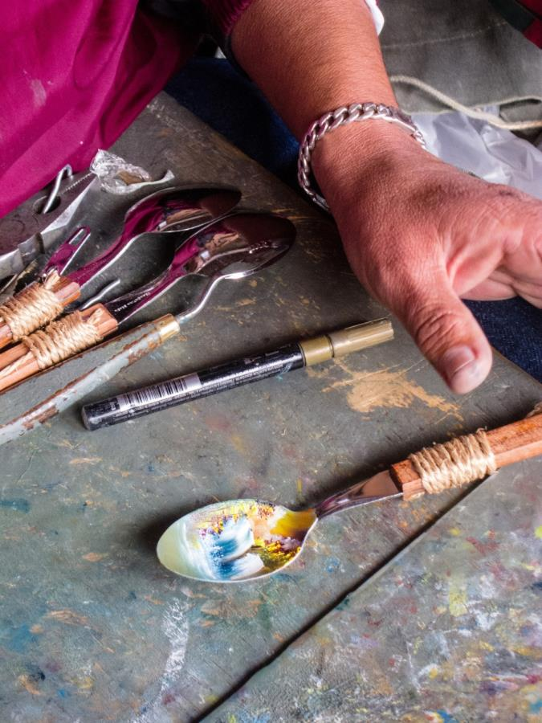
Painted Spoon © David Morris

Slide 3
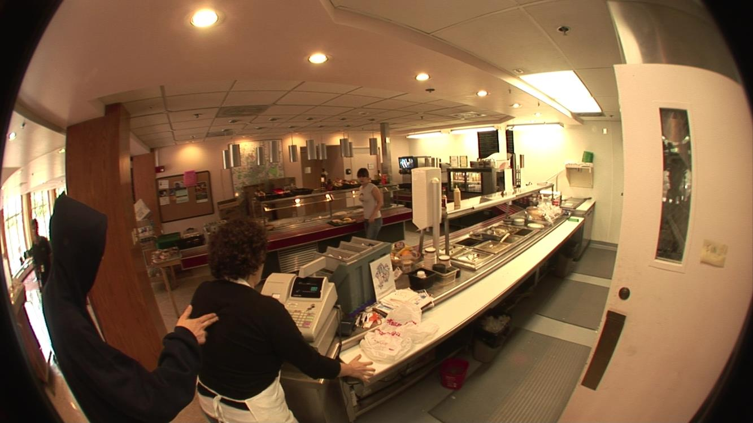
Photos Solve Crimes
Simulated café robbery from Public Safety Communication Research (PSCR) laboratory, http://www.cdvl.org/

Slide 4
“Video is not an accurate media”
Grant Fredericks
Law Enforcement Video Association (LEVA)
LEVA Level 3 Photographic/Video Comparison

Slide 5
“What image quality do you get from your cameras?”

Slide 6
“Excellent” “Good” “Fully Satisfactory”

Slide 7
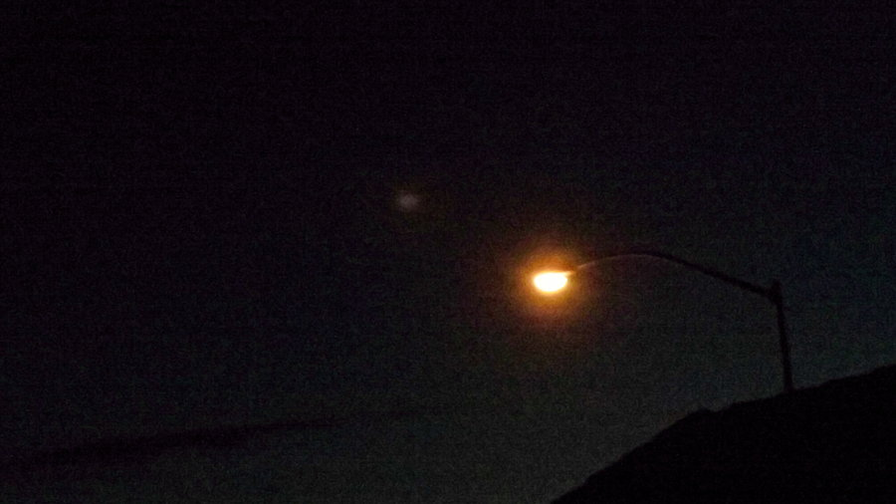
What is your image quality?
“Street light, this dark night,” ©2011-2016 mayaMyChemRo, http://mayamychemro.deviantart.com/

Slide 8
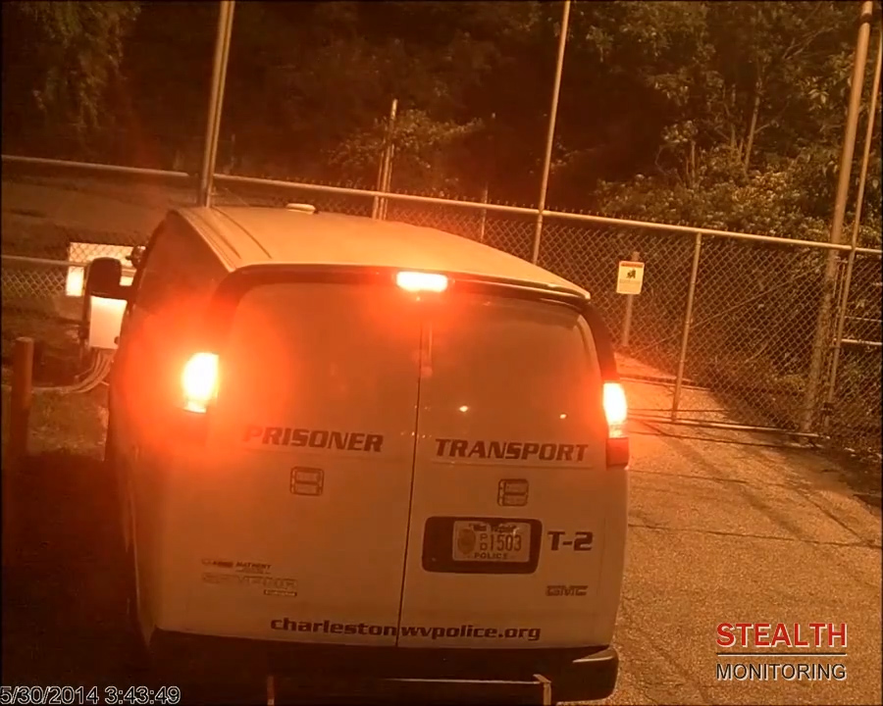
What is your image quality?
© 2016 Stealth Monitoring, http://stealthmonitoring.com/

Slide 9
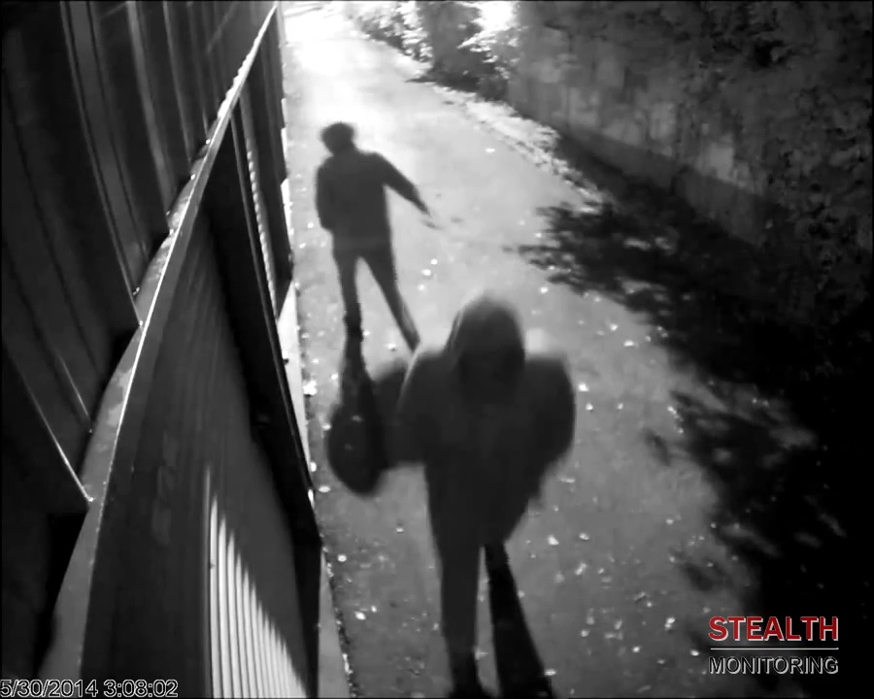
But your images…
© 2016 Stealth Monitoring, http://stealthmonitoring.com/

Slide 10
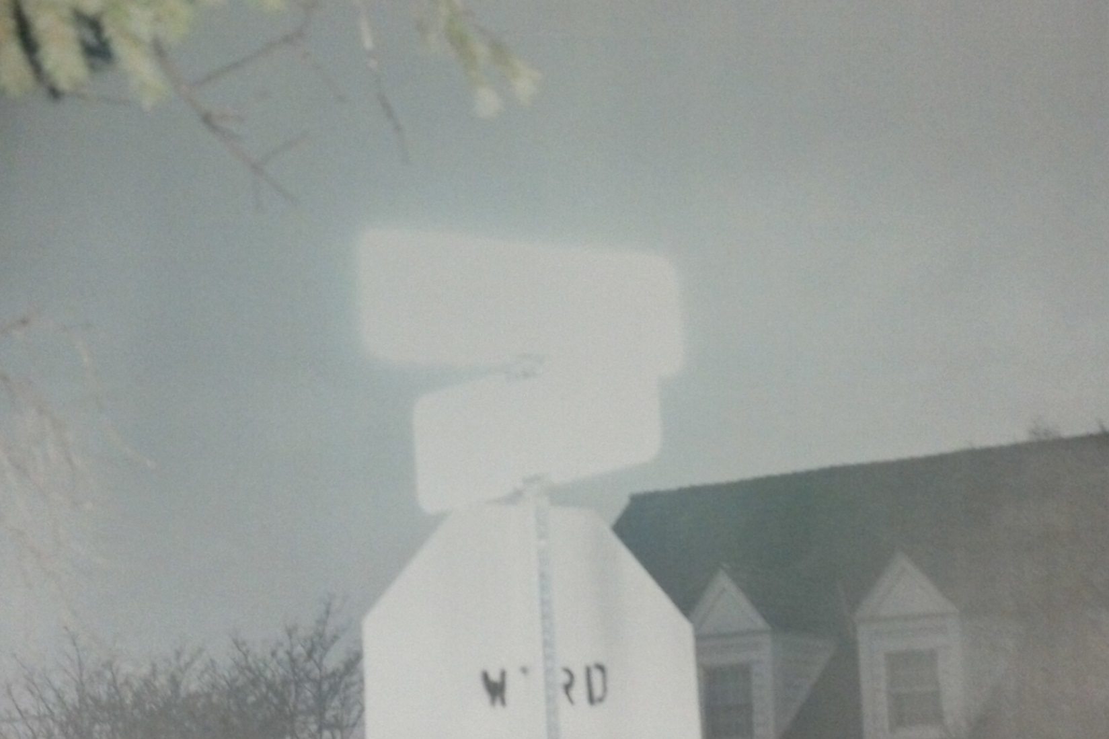
But your images…

Slide 11
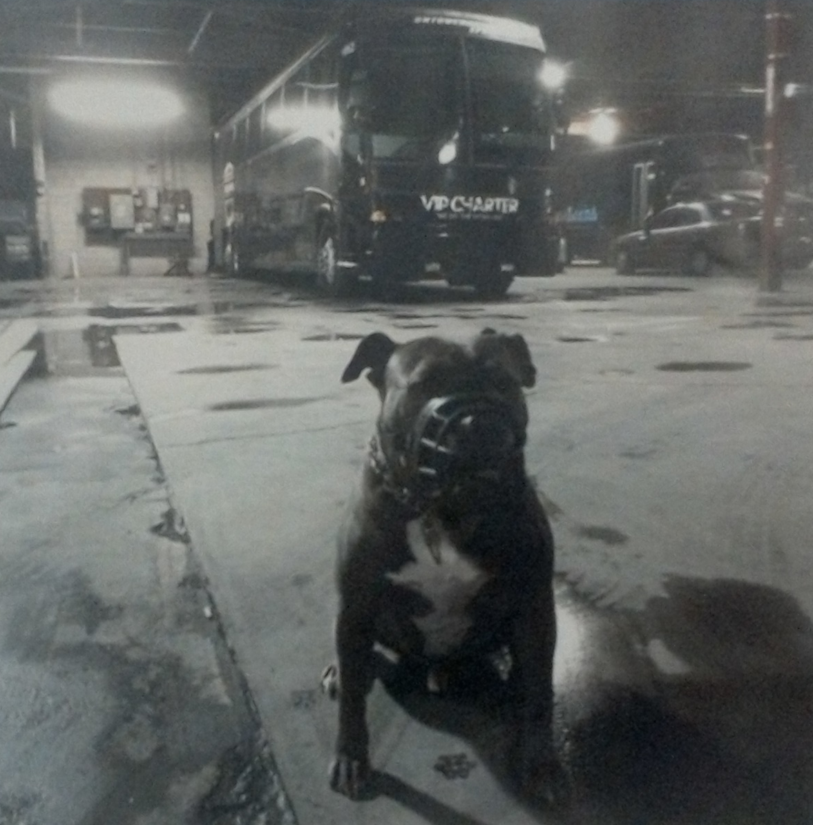
But your images…

Slide 12
“What Situations Are Difficult?”

Slide 13
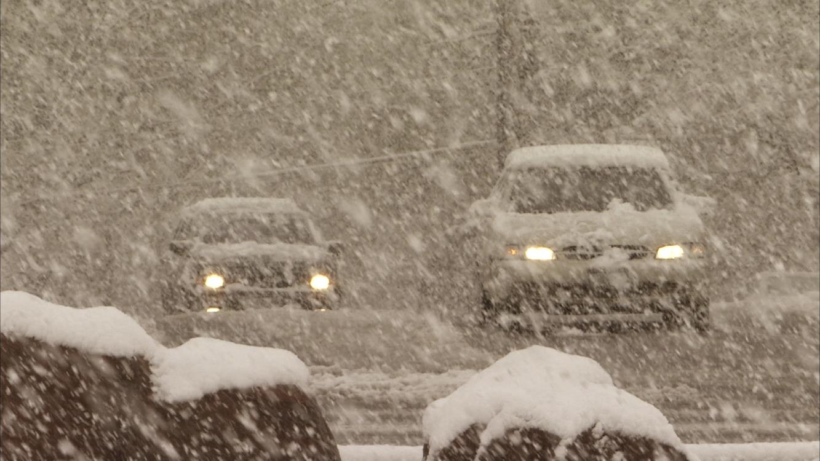
Falling Snow
“NTIA intersection on a snowy day (6a),” Consumer Digital Video Library: http://www.cdvl.org/

Slide 14
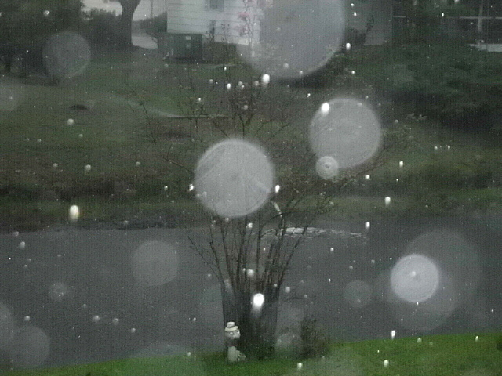
Rain
©Kerrie O'Hearn Marquart, Raindrops on my camera lens looking out of my den window, http://kerrieshomejournal.blogspot.com/2011/08/you-will-never-walk-alone.html, 8/12/2016

Slide 15
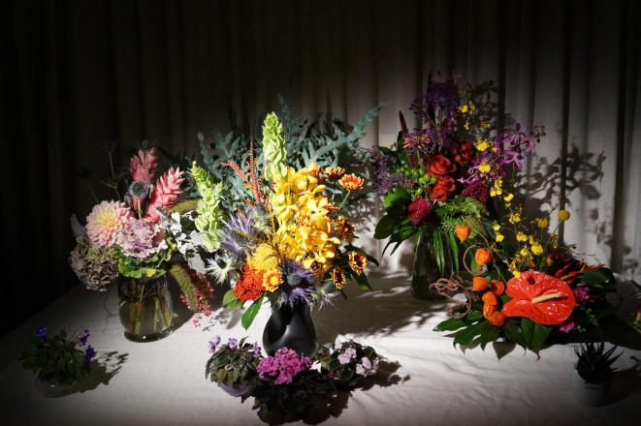
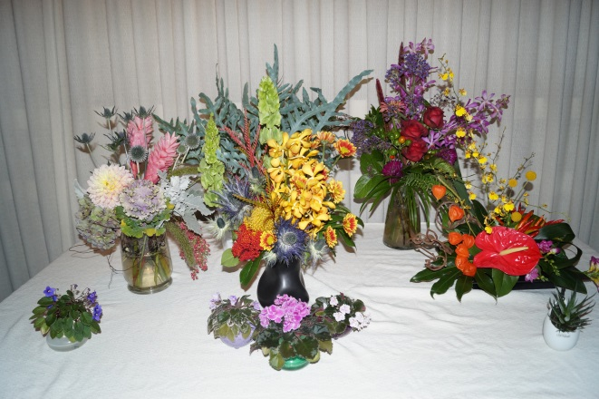
Night or Bright Lights
"Impact of Camera Pixel Count and Monitor Resolution Perceptual Image Quality," Colour and Visual Computing Symposium (CVCS), 2015, Gjovik, Norway, 25-26 August 2015, Michele A. Saad et al. http://www.cdvl.org/

Slide 16
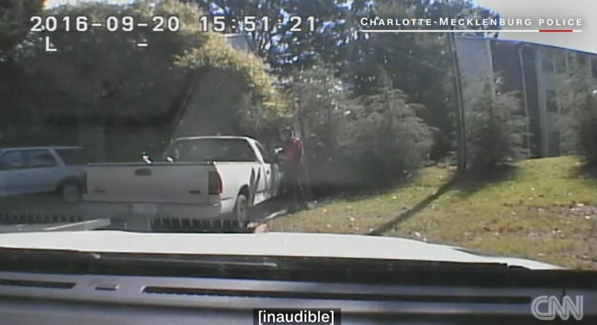
What is the Shape?
“Charlotte shooting: Police release video and photo evidence,” http://www.cnn.com/ September 24, 2016
© 2016 Cable News Network. Turner Broadcasting System, Inc. All Rights Reserved.

Slide 17
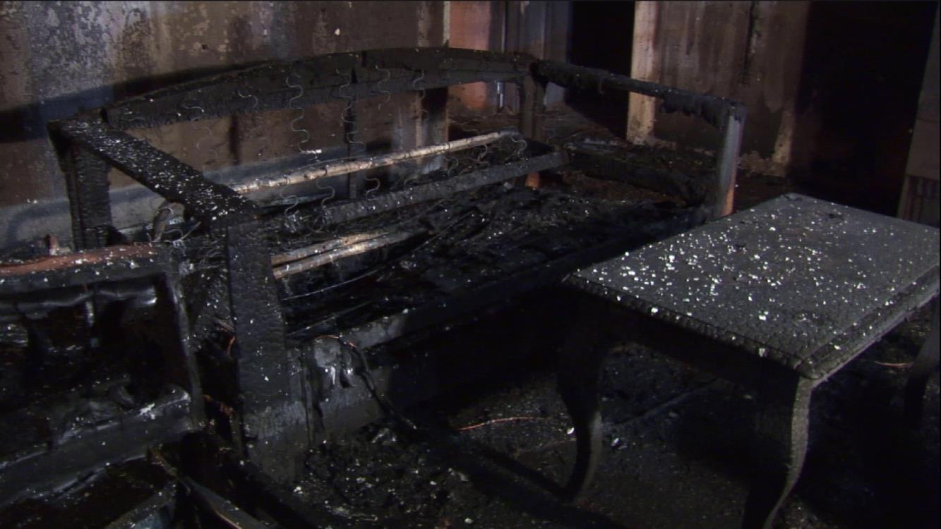
Distinguishing Similar Shades?
UL controlled burn, from Public Safety Communication Research (PSCR) laboratory, http://www.cdvl.org/

Slide 18
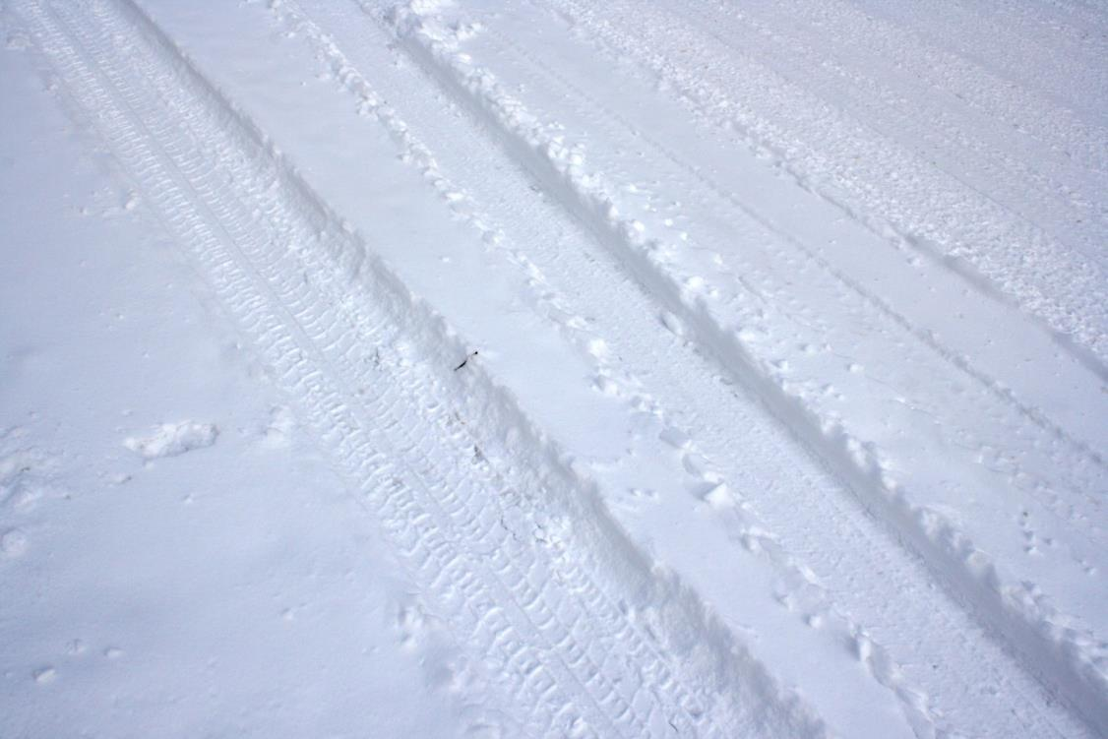
Angle
“Snow Packed Road,” http://www.photos-public-domain.com/2011/

Slide 19
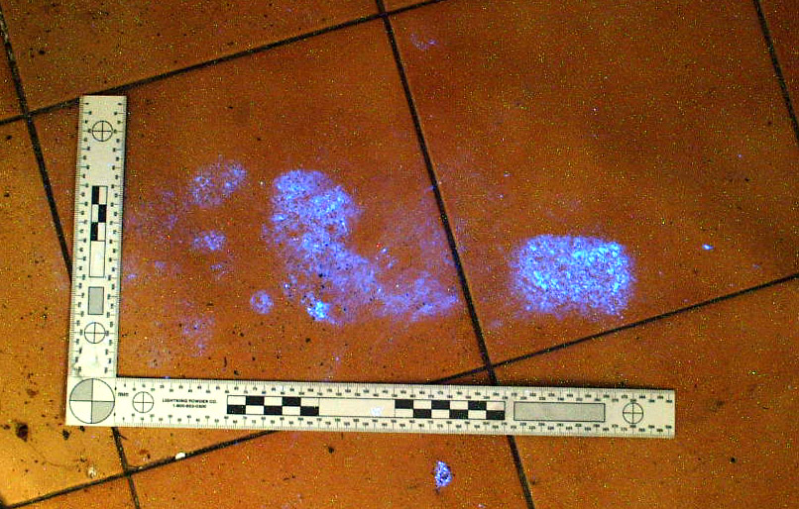
Size?
http://www.bluestar-forensic.com/ Pictures Copyright (© )BLUESTAR®

Slide 20
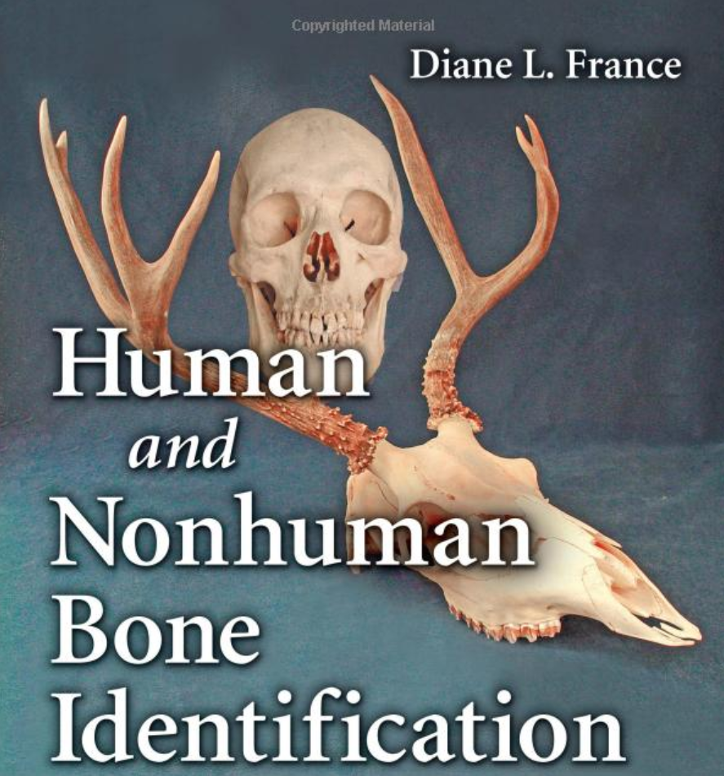
Focus?
“Human and Nonhuman Bone Identification: A Color Atlas 1st Edition,” by Diane L. France, © 2008

Slide 21
What About Color?

Slide 22
“Color is unreliable.”

Slide 23
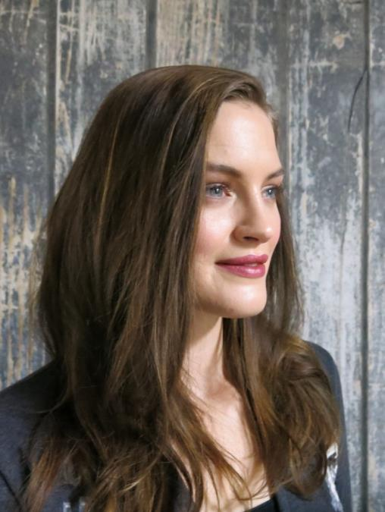
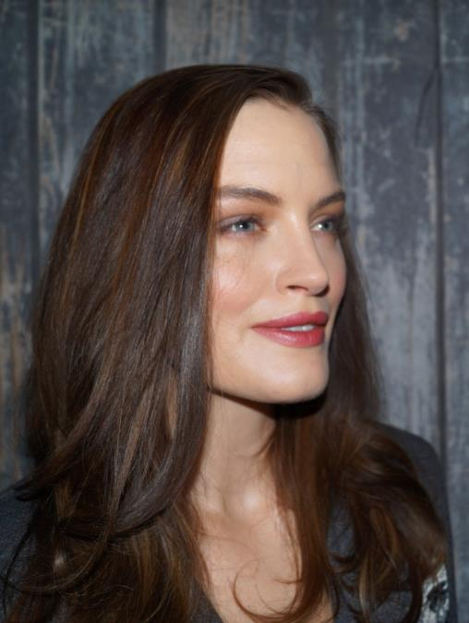
Color is Unreliable
"Impact of Camera Pixel Count and Monitor Resolution Perceptual Image Quality," Colour and Visual Computing Symposium (CVCS), 2015, Gjovik, Norway, 25-26 August 2015, Michele A. Saad et al. http://www.cdvl.org/

Slide 24
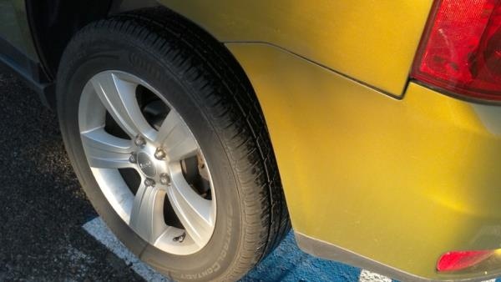
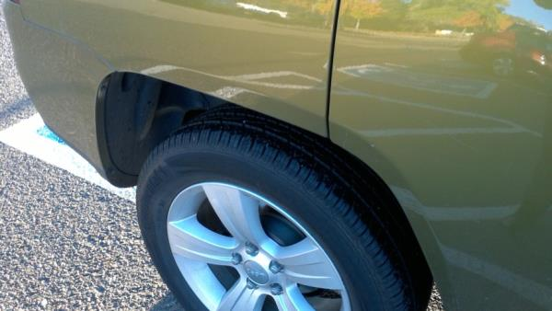
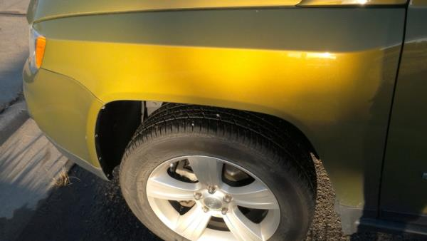
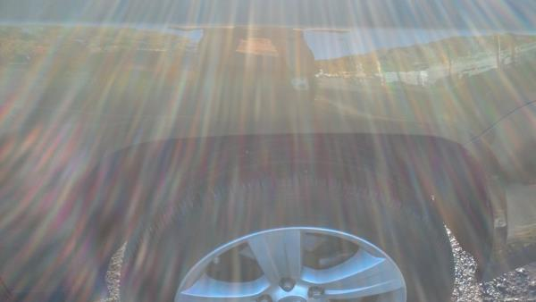
Color Is Unreliable

Slide 25
How do we ask about quality?

